Slide 1

Data science in context A brief history of data storage-analysis
Presented by Alexis Mekueko

Slide 2
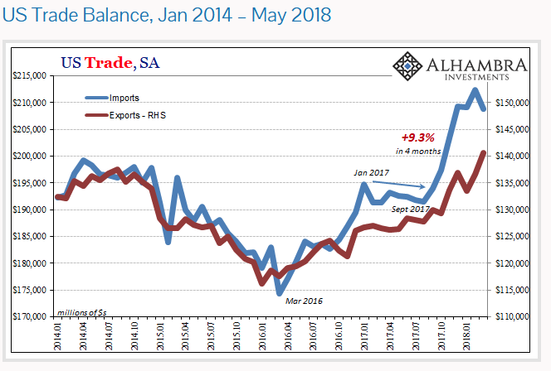
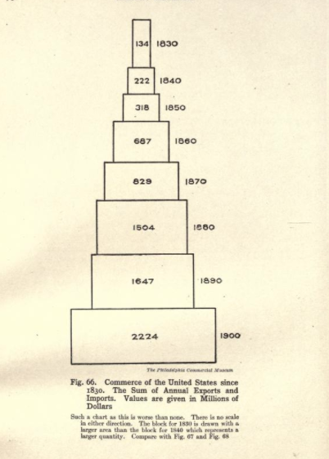
Contrast of Data Visualization 1830-2018

Slide 3
Data as Qualitative and Quantitative information
1830-Willard Cope Brinton, a consulting engineer and a pioneer in data visualization. In 1914 he published "Graphic methods for presenting facts“
1943- the ENIAC computing system was built by John Mauchly and J. Presper Eckert at the Moore School of Electrical Engineering of the University of Pennsylvania.
Random Access Memory (RAM) In 1948 by Professor Fredrick Williams, and colleagues.
1958- Jack S. Kilby and later Robert Noyce were pioneers for the invention of the Integrated Circuit.
In 1960, Charles W. Bachman designed the Integrated Database System, the “first” DBMS. IBM,
1962- John Tukey published “The Future of Data Analysis.” in the The Annals of Mathematical Statistics.
1974 - Peter Naur published the ”Concise Survey of Computer Methods”, 1st time the term “Data Science” is defined: “The science of dealing with data, once they have been established, while the relation of the data to what they represent is delegated to other fields and sciences.”
1989, the first Knowledge Discovery in Databases (KDD) workshop was organized (core of the process is -finding knowledge in data).
1997 - 2005- from Michael Cox and David Ellsworth published “Application-controlled demand paging for out-of-core visualization” for the IEEE 8th conference on visualization then, Roger Mougalas from O'Reilly Media extended big data to Web 2.0 …later Hadoop was created by Yahoo!
From 2010 to 2020 data science has been growing at fast rate….

Slide 4
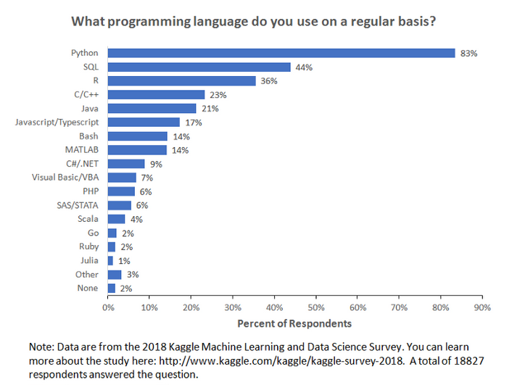
How is data used today?
Companies use data to: make projection, help in decision making, get a roadmap, analyze past issues, research for innovation in nearly all domain in the .
Programming languages:
Mackenzie Mitchell
Apps for data scientists:
Power BI- Tableau
IBM Cognos- Qlik- DataEye
Data Counter Widget- Glasswire
Data Monitor – My Data Manger
Airdroid- MiXplorer Silver
Resilio Sync-Solid Explorer- SAP BusinessObjects
Roambi - Salesforce Wave - SAS Mobile BI
Oracle Business Intelligence – Splunk
Google Analytics

Slide 5
The Future is Zettabyte
As AI and Machine Learning momentum is rapidly spreading in technology, much more resources would be needed.
Cloud
Big data center
Powerful applications
My recommendation: get certified in one application of your choice
Exam 70-778: Analyzing and Visualizing Data with Microsoft Power BI
Exam DA-100: Analyzing Data with Microsoft Power BI
IDC predicts that the Global Datasphere will grow from 175 Zettabytes by 2025

Slide 6
References
Graphic methods for presenting facts by Brinton, Willard Cope, 1914
https://archive.org/details/graphicmethodsfo00brinrich/page/70/mode/2up
US Trade Balance, Jan 2014 – May 2018
https://snbchf.com/2018/05/snider-watching-imports/abook-may-2018-usexim-sa-png/
Beginner’s Guide to the History of Data Science
https://dataconomy.com/2016/03/beginners-guide-history-data-science/
https://www.kdd.org/kdd2015/
A Brief History of Database Management
https://www.dataversity.net/brief-history-database-management/
History of Computers: A Brief Timeline
https://www.livescience.com/20718-computer-history.html
A Very Short History Of Big Data
https://www.forbes.com/sites/gilpress/2013/05/09/a-very-short-history-of-big-data/?sh=6594d8965a18
The Digitization of the World From Edge to Core
https://www.seagate.com/files/www-content/our-story/trends/files/idc-seagate-dataage-whitepaper.pdf
How Big is Big Data?
https://towardsdatascience.com/how-big-is-big-data-3fb14d5351ba
Programming Languages For Data Scientists
https://towardsdatascience.com/programming-languages-for-data-scientists-afde2eaf5cc5
Power BI certification:
https://docs.microsoft.com/en-us/learn/certifications/exams/70-778
https://docs.microsoft.com/en-us/learn/certifications/exams/da-100

